Slide 1
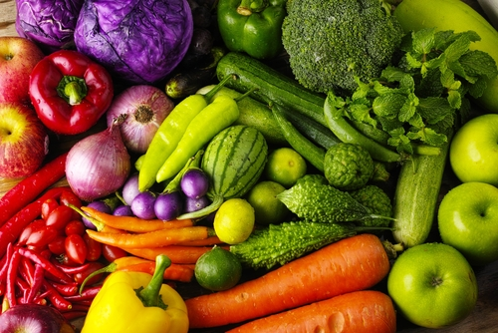

ORGANIC FARMING MADE EASY
Group Members:
Aishwarya Sawant (001059228)
Pranali Ninawe (001377887)
Vaibhav Dhoke (001342995)

Slide 2
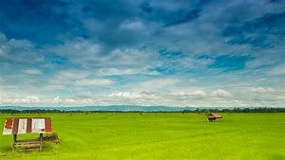





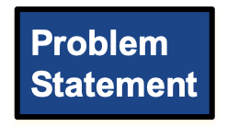


Slide 3

PROBLEM STATEMENT
Farmers are faced with new challenges and opportunities every day:
Organic products are very costly because of their small scale production and because chemicals are not used in the production
People are unaware about the authenticity of the organic products
Farmers are unable to foresee the demand for their production,Organic farmers are generally unaware of the best farming practices because organic farming is not yet very popular
Farmers don’t opt for organic farming because of their
financial instability

Slide 4




SOLUTION
Expert certified products are sold on the portal to the consumers directly
Government provide distributors to ensure the delivery of the organic crops
Open forum that enables farmers to discuss/ask about the best farming practices
Farmers are provided the treatment for their health issues
Government arrange for educational events for the farmers
Farmers can view yearly trends for all the crops to forsee the demand of crops
Government will encourage organic farming by providing subsidies

Slide 5

APPROACH
Generating requests
Passing the request from one organization to the other
Passing the request from one enterprise to the other
Maintaining Work Queue and Work Request for a
UserAccount and Organization

Slide 6
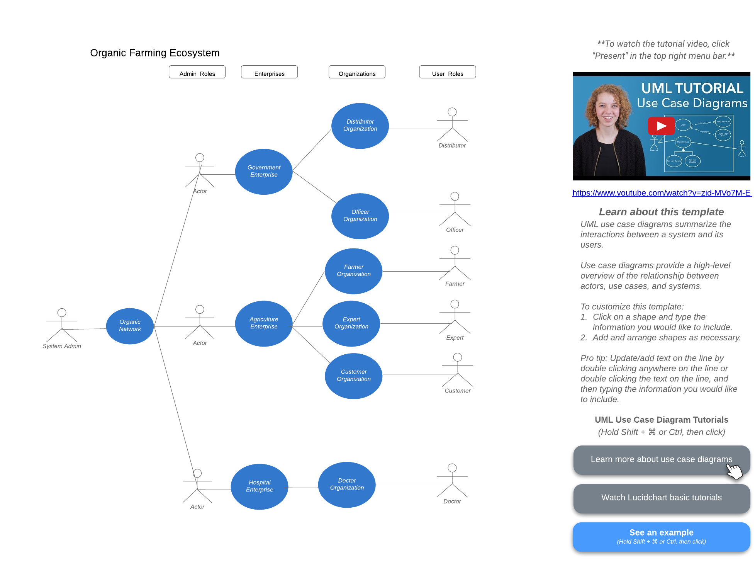
USE CASE

Slide 7
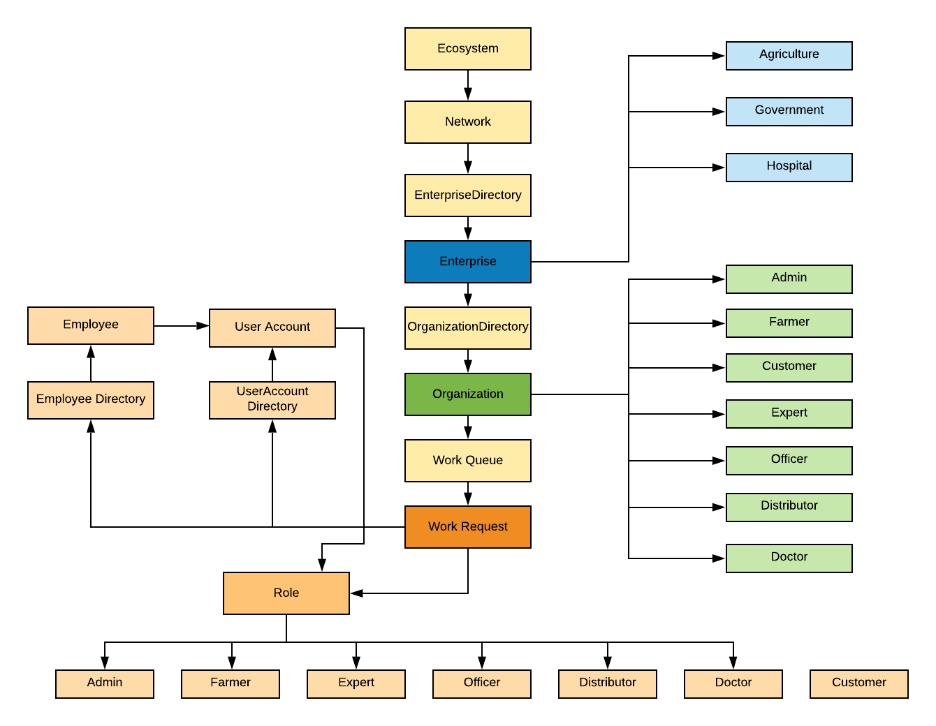
DESIGN

Slide 8
WORK FLOW
OrganicCertificationWorkRequest FarmerEventsWorkRequest
FarmerCropWorkRequest CustomerOrderWorkRequest
FarmerTreatmentWorkRequest
FarmerSubsidyWorkRequest
Farmer
Expert
Officer
Farmer
Farmer
Customer
Customer
Farmer
Farmer
Doctor
Farmer
Officer

Slide 9
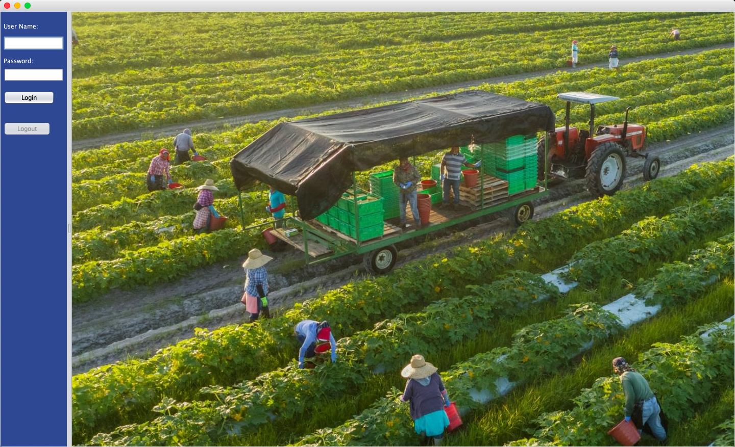
KEY SCREENSHOTS

Slide 10
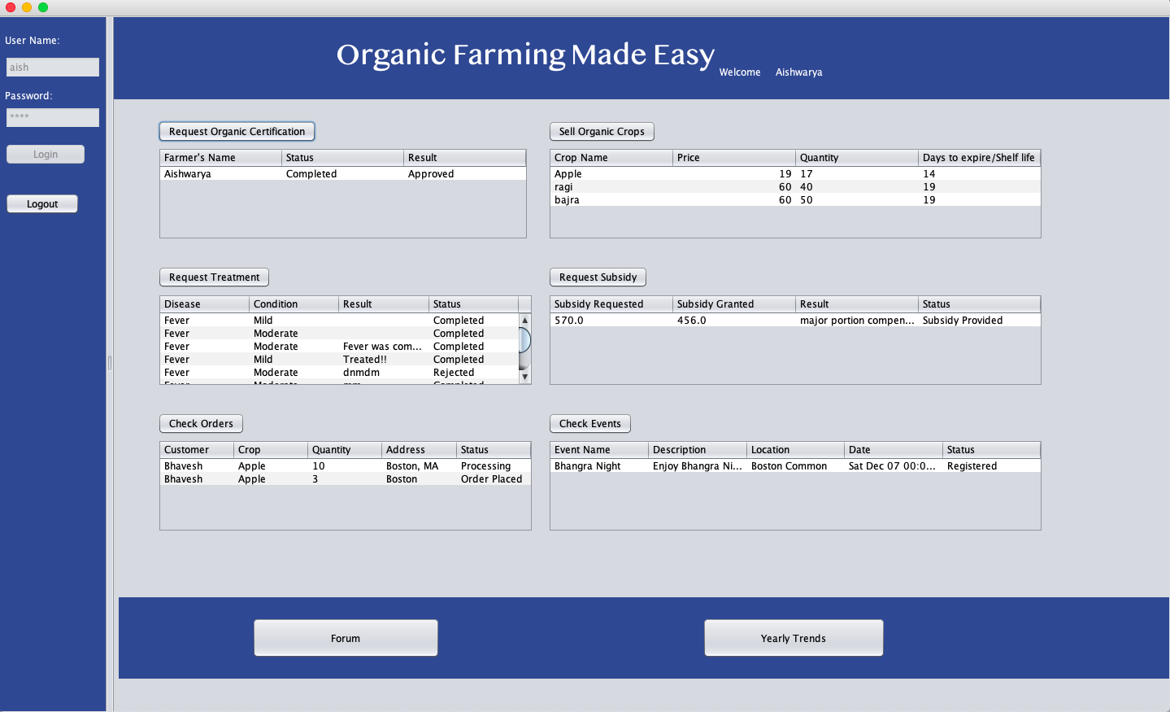

Slide 11
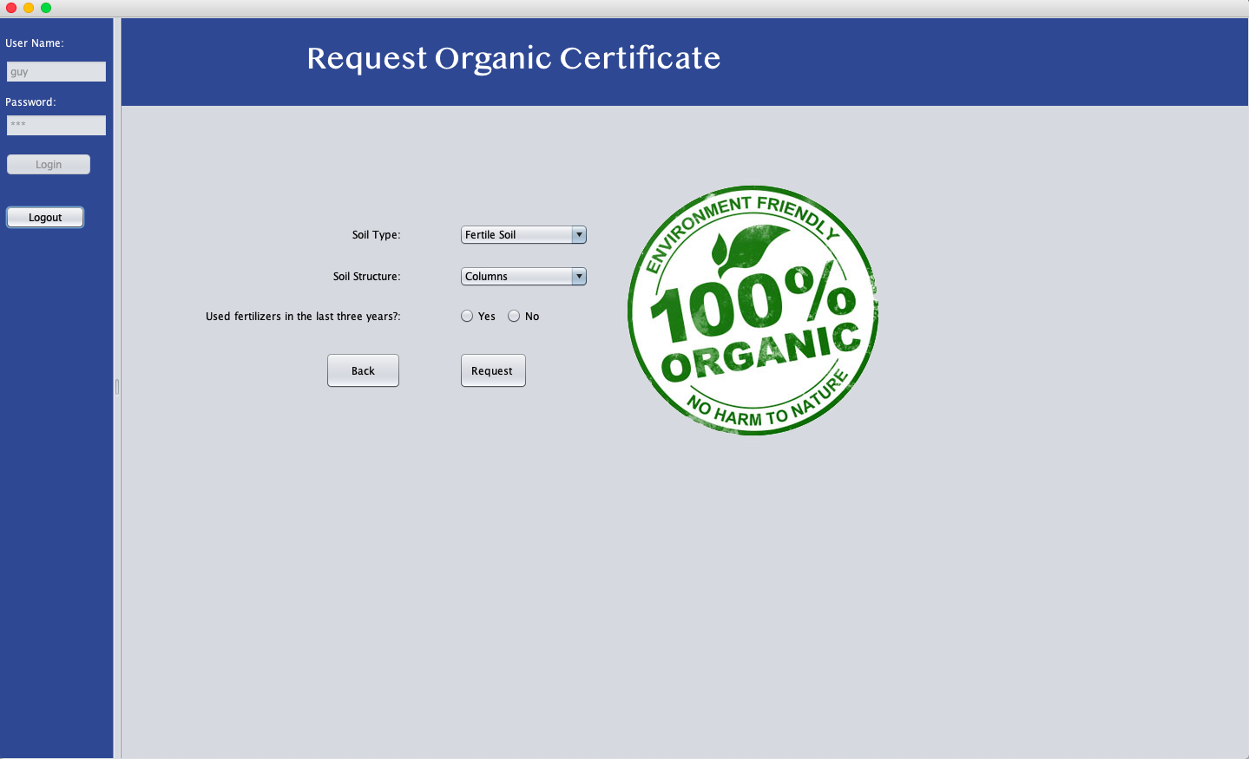

Slide 12
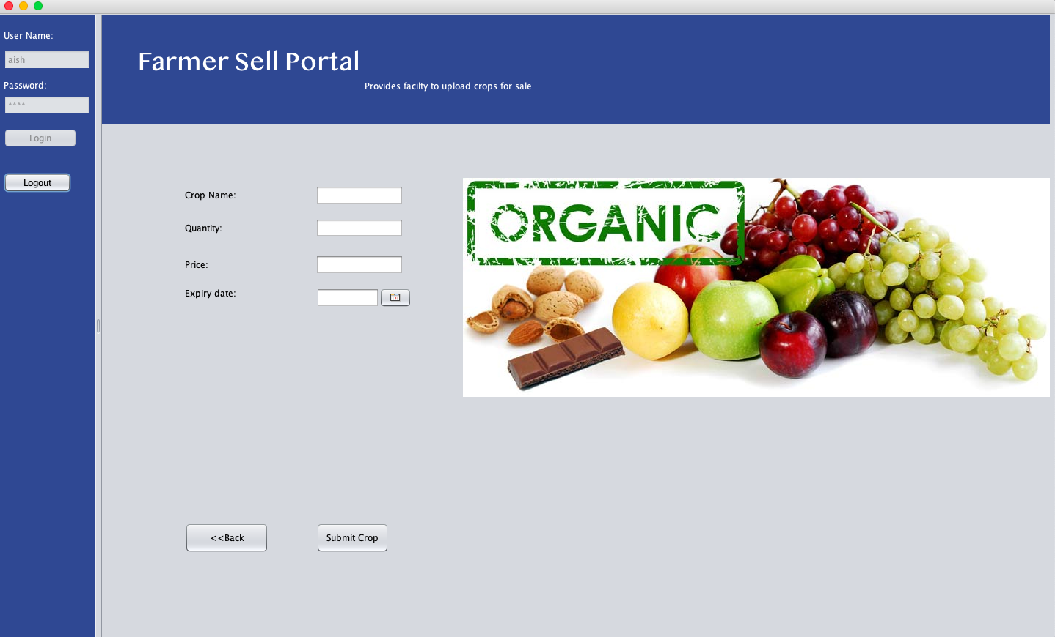

Slide 13
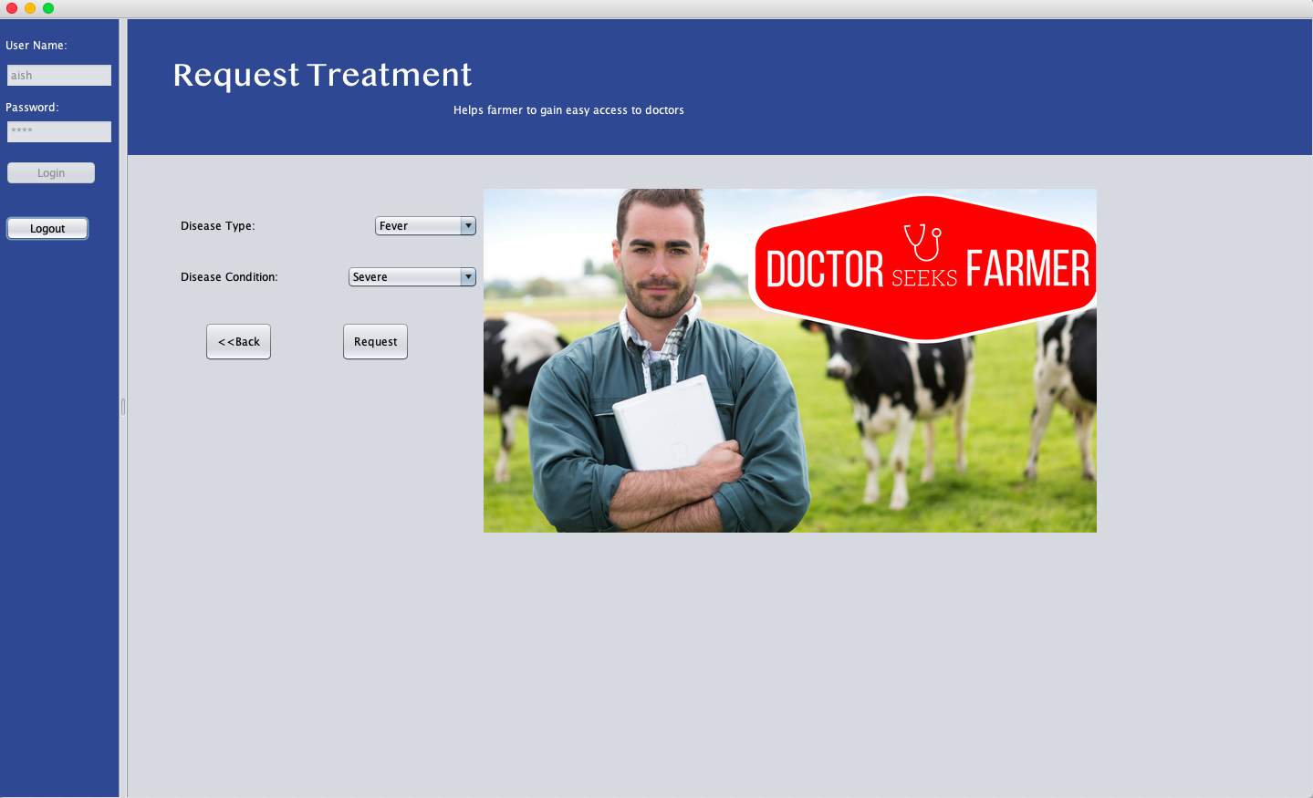

Slide 14
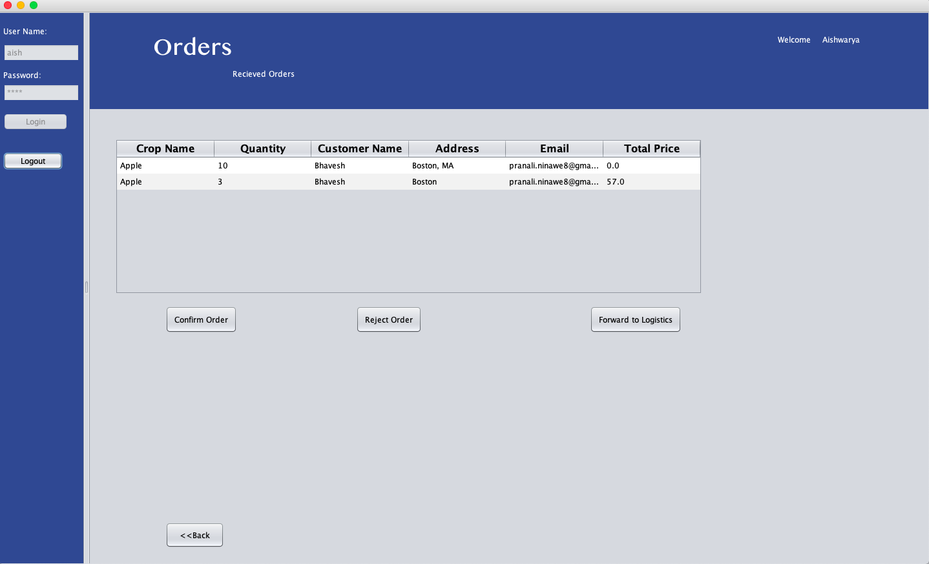

Slide 15
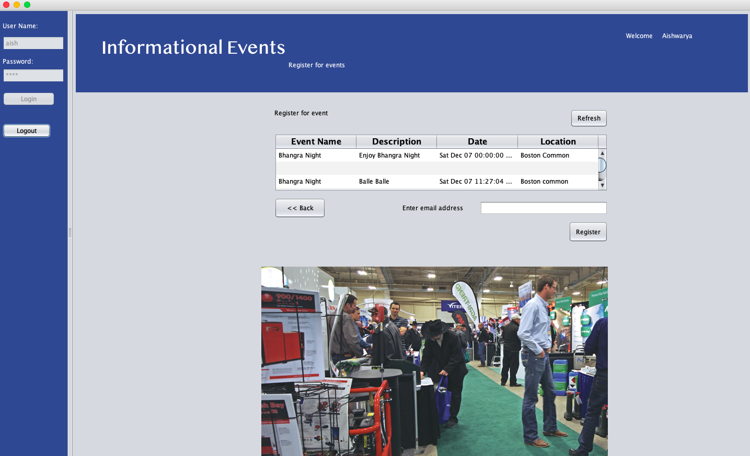

Slide 16
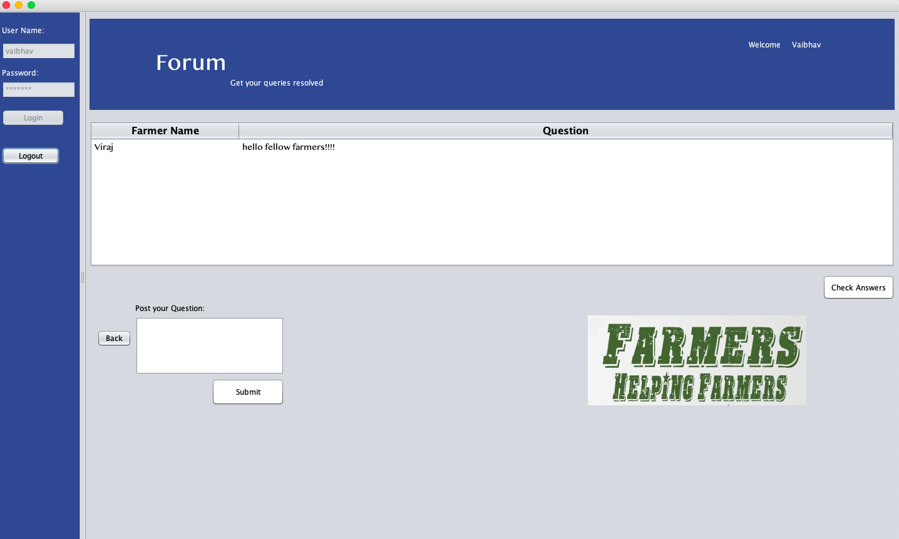

Slide 17
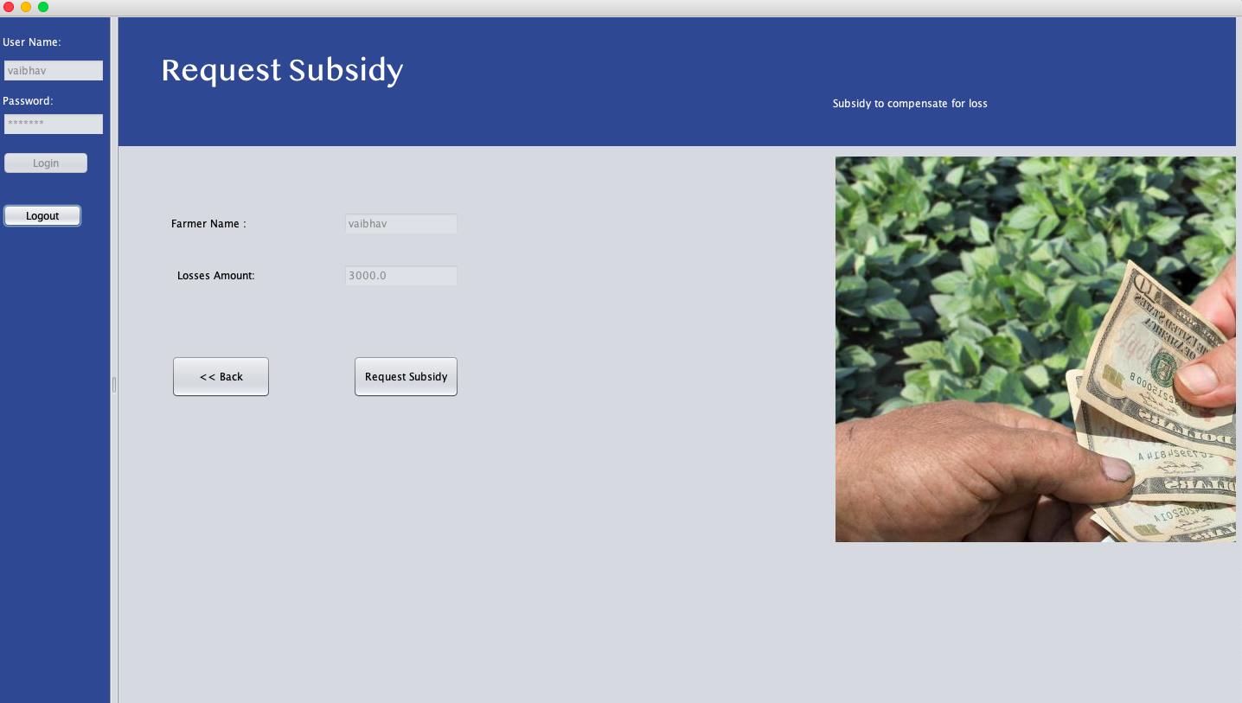

Slide 18
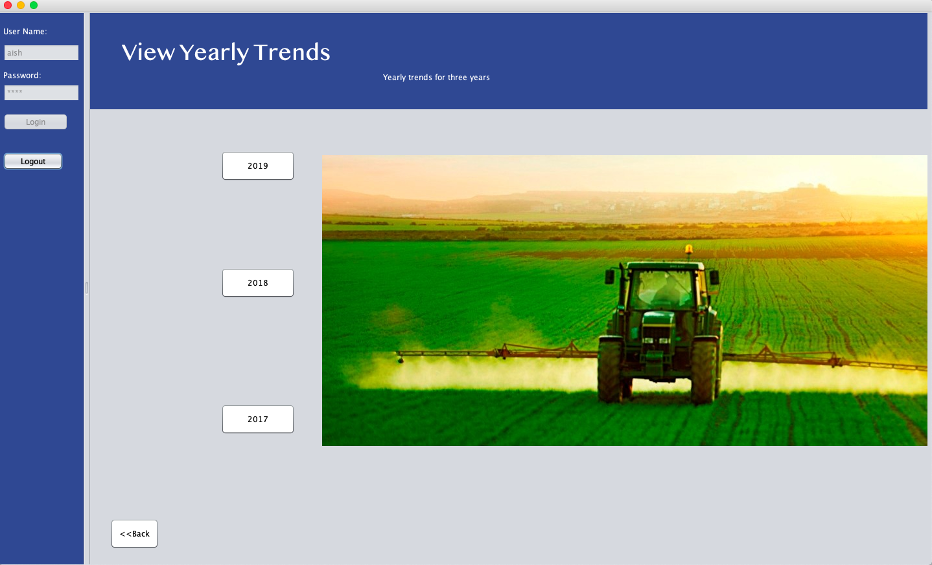

Slide 19
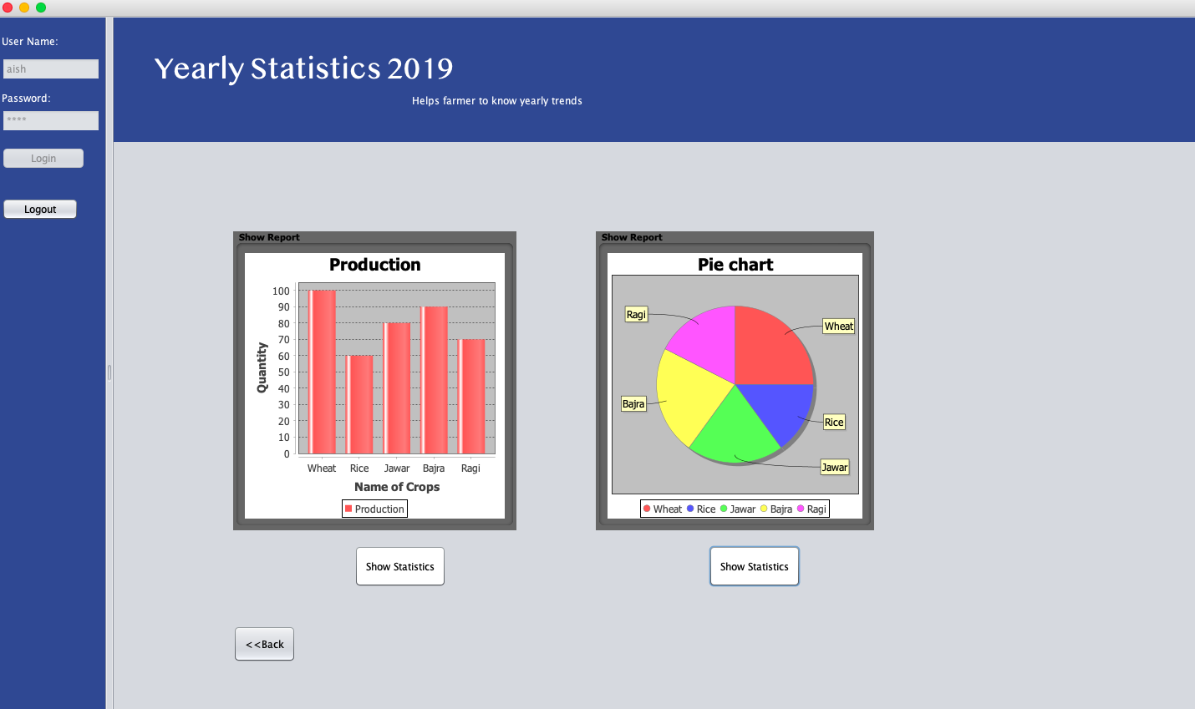

Slide 20
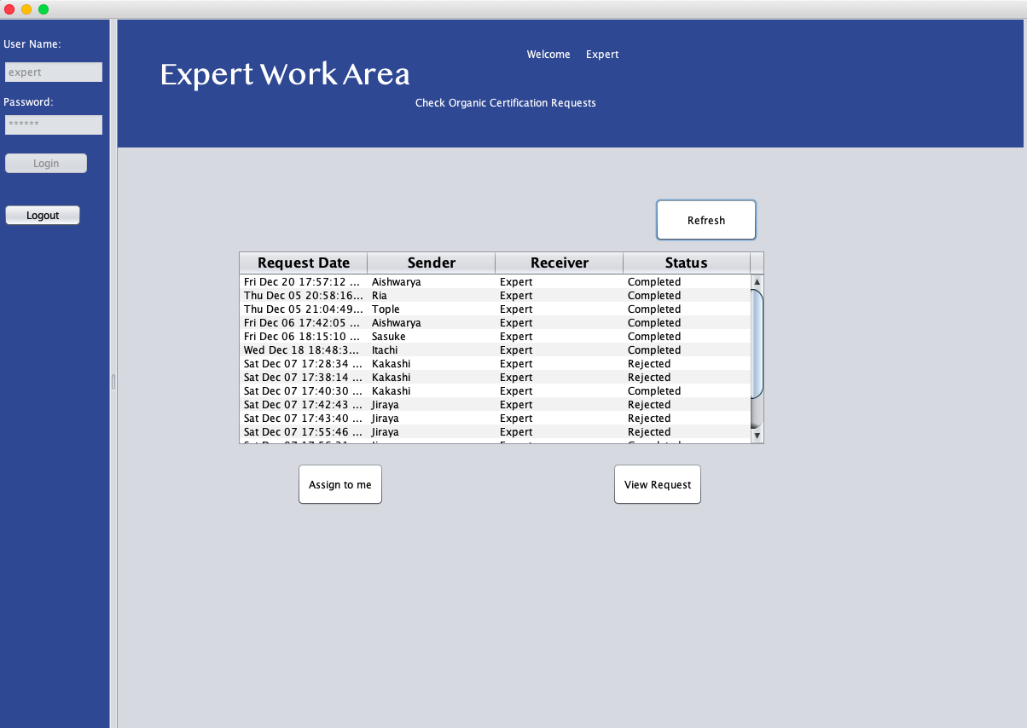

Slide 21
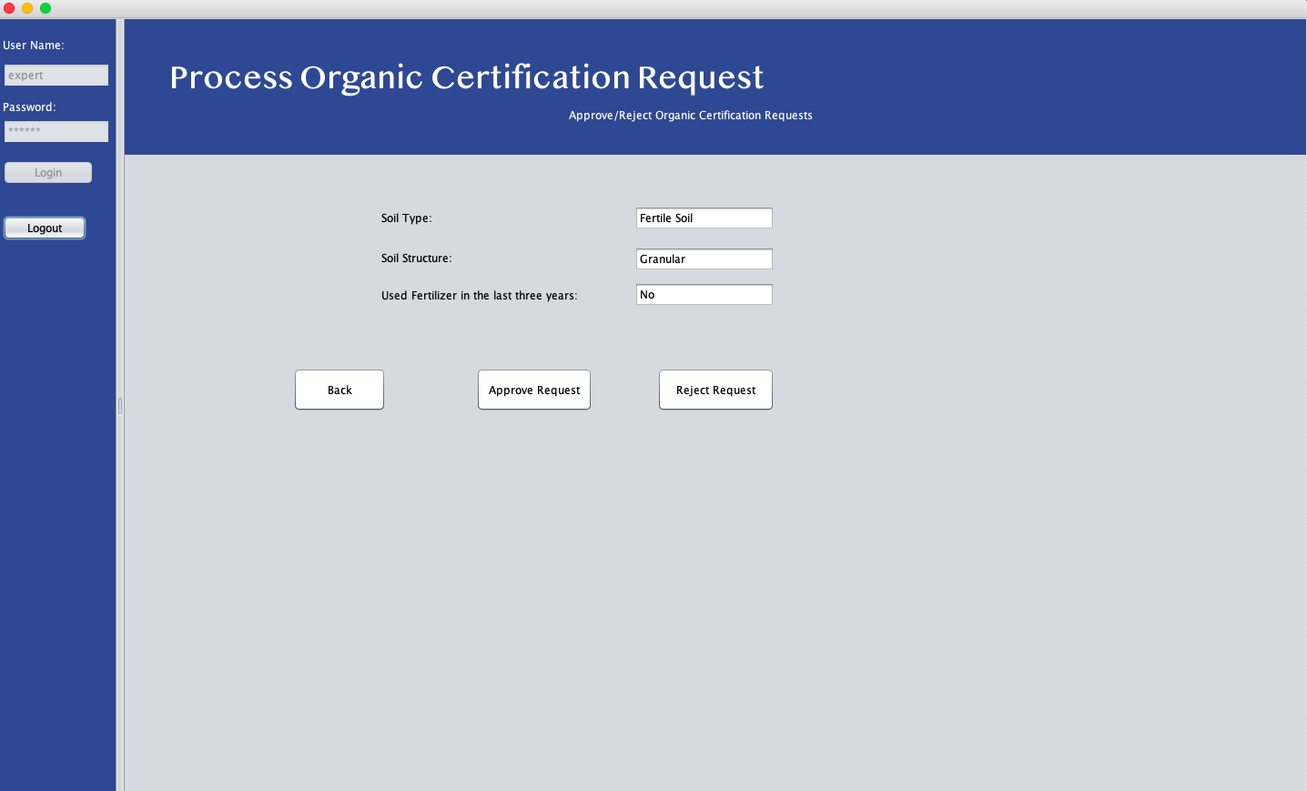

Slide 22
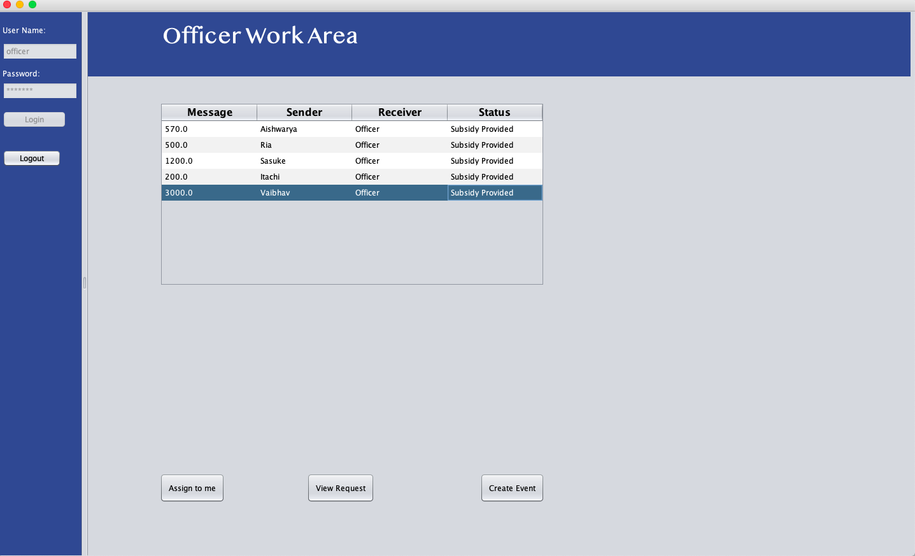

Slide 23
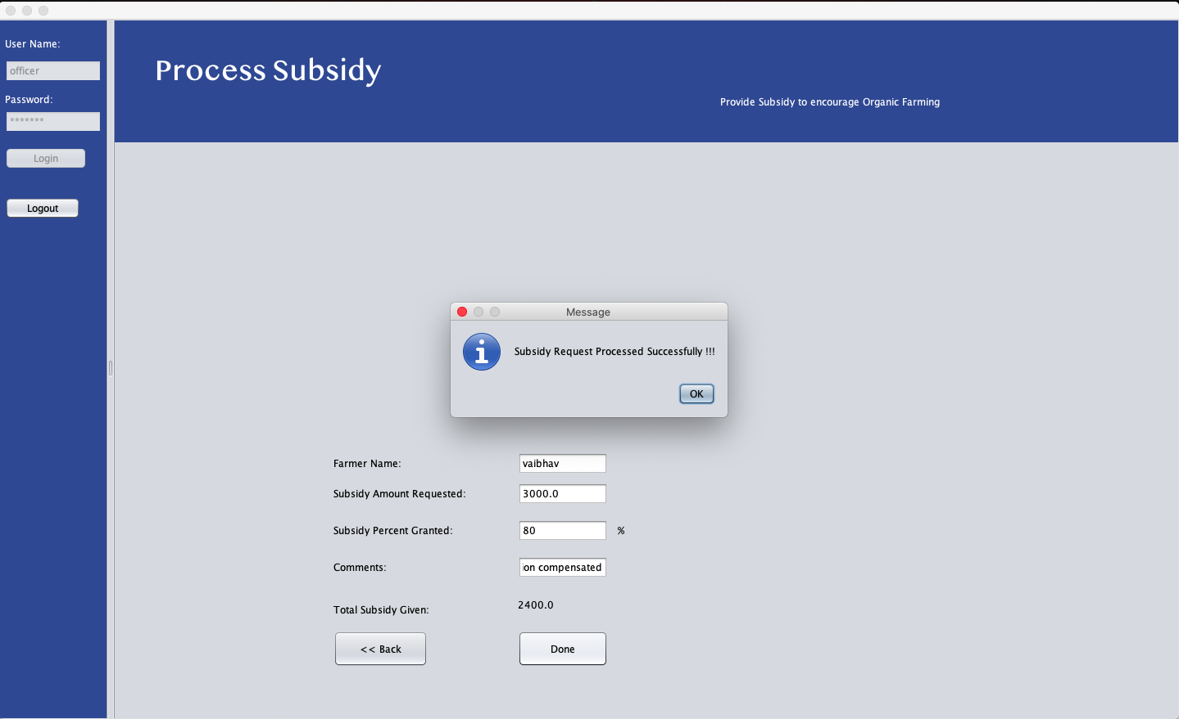

Slide 24


Slide 25
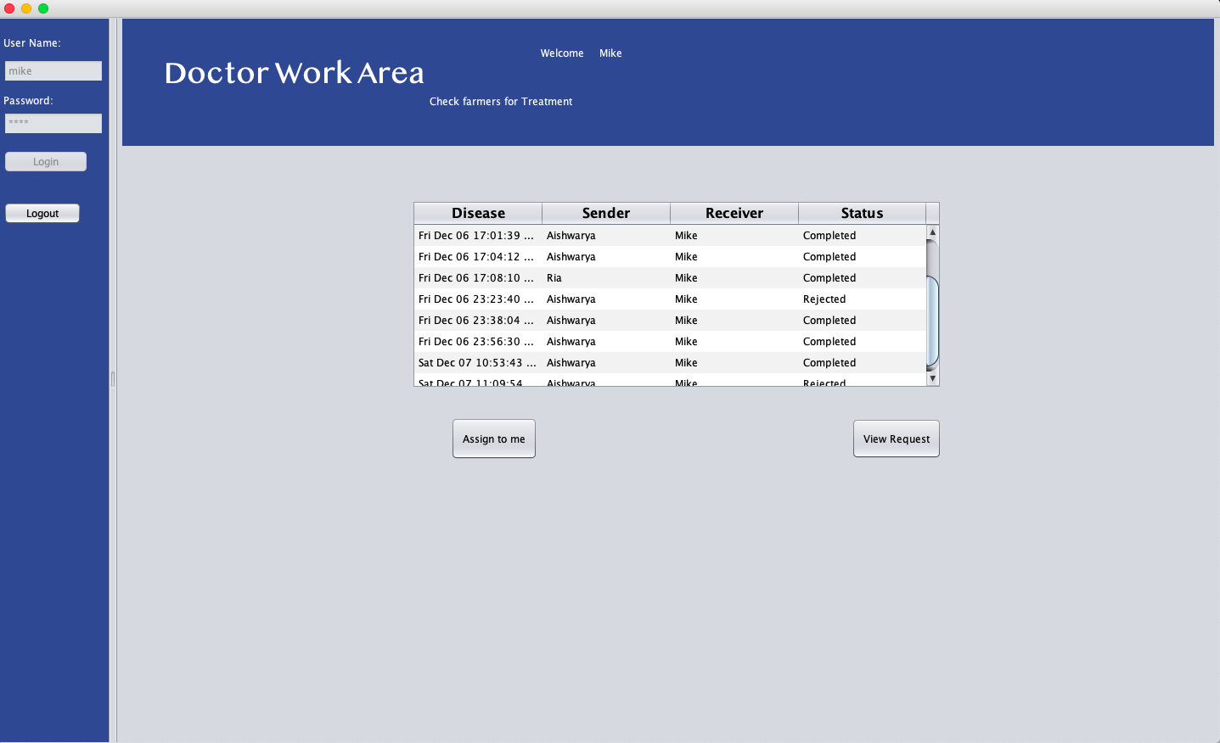

Slide 26
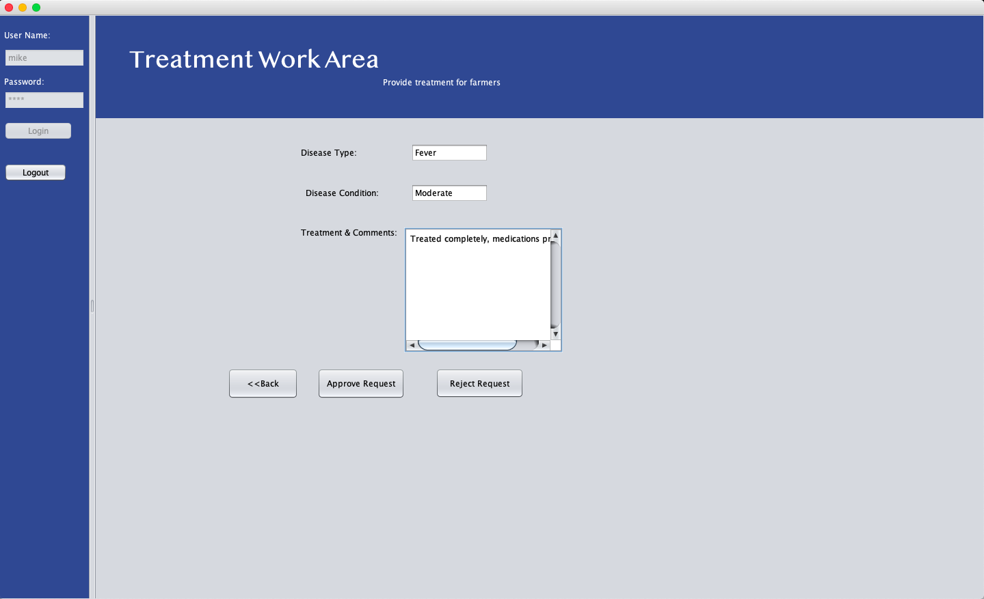

Slide 27
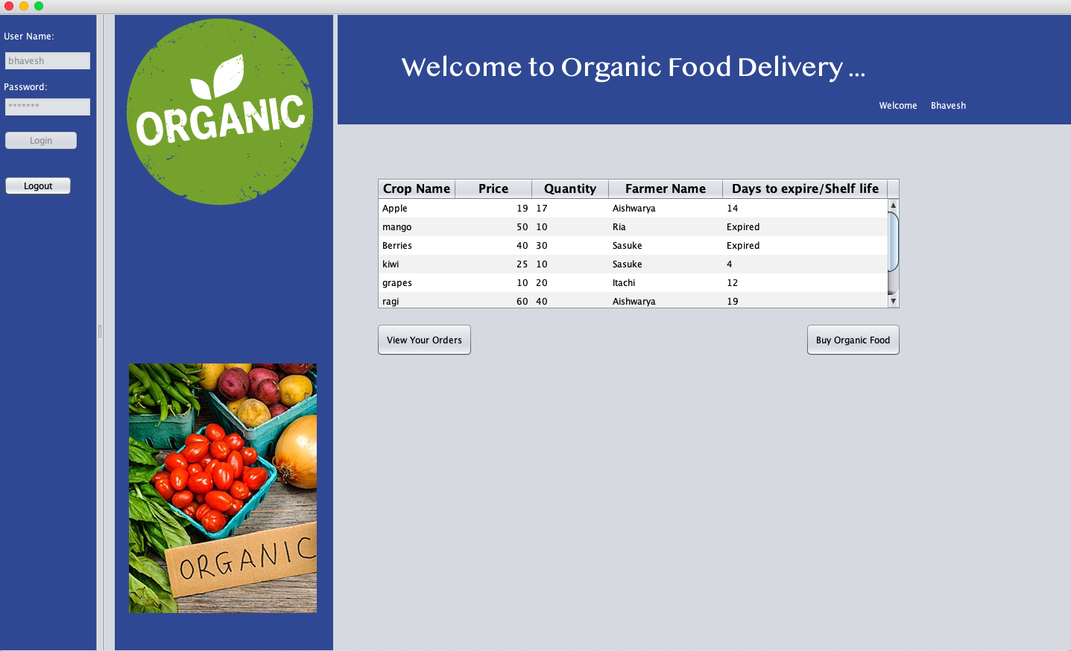

Slide 28
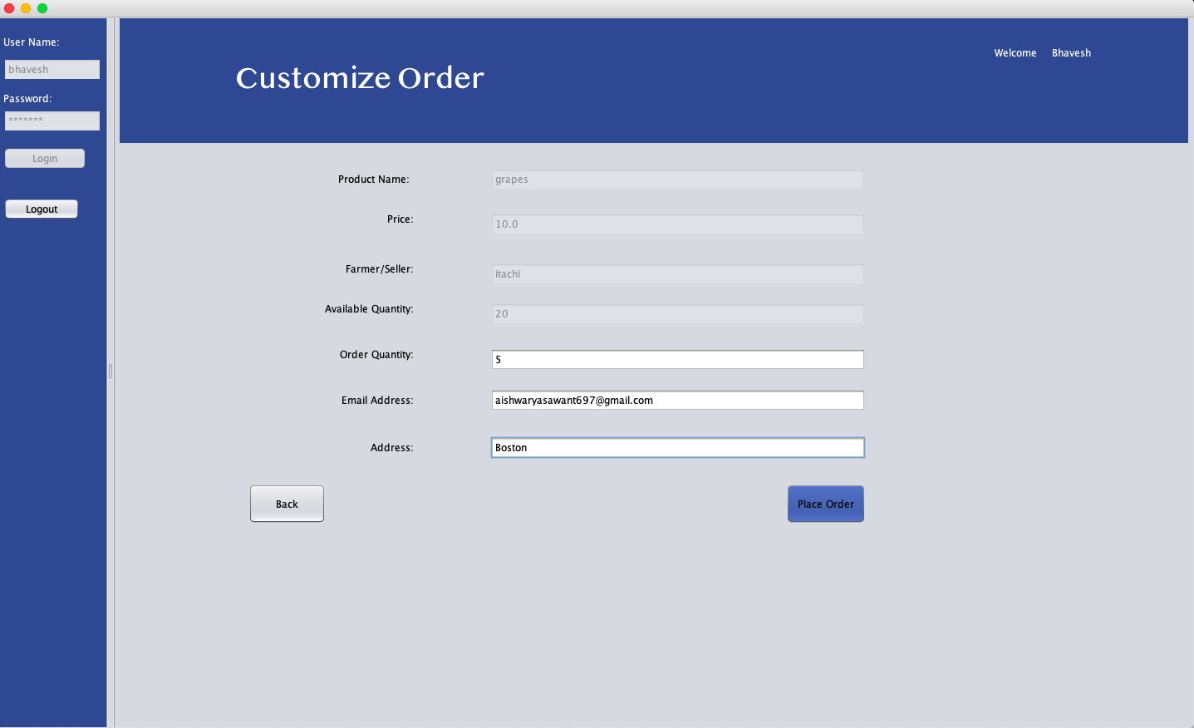

Slide 29


Slide 30


THANK YOU !!

